Slide 1
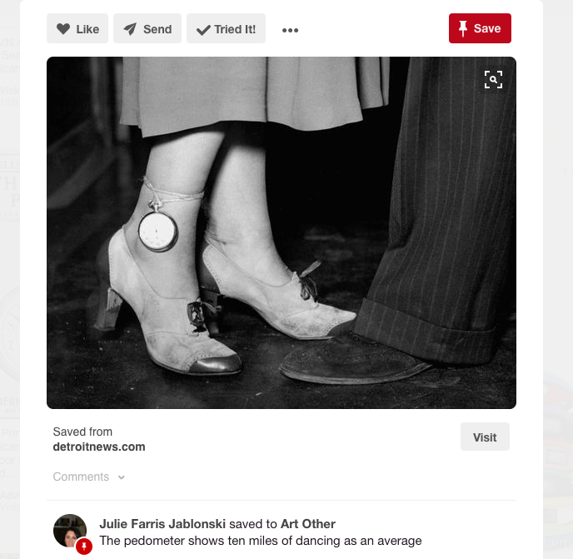
Numbered Lives:
Life & Death in Quantum Media
Jacqueline Wernimont, Ph.D.
Analog available through MIT University Press, November 2018

